Slide 1
Welcome!
Thank you for participating in our experiment!
IMPORTANT: YOU MUST STAY IN FULL SCREEN MODE FOR THE ENTIRE EXPERIMENT OR YOU WILL NOT BE PAID
Your browser is now in full screen mode.
If you leave full screen mode for any reason, you will exit the experiment, and you will return to Prolific without payment. Please remain in full screen mode for the whole experiment, which will take approximately 30-40 minutes.
Notes:
xxxx

Slide 2
In this experiment you will learn to identify 8 different kinds of rocks,
like obsidian, pumice, etc.
If you do a good job learning to identify the rocks you will earn an additional $3 bonus payment.

Slide 3
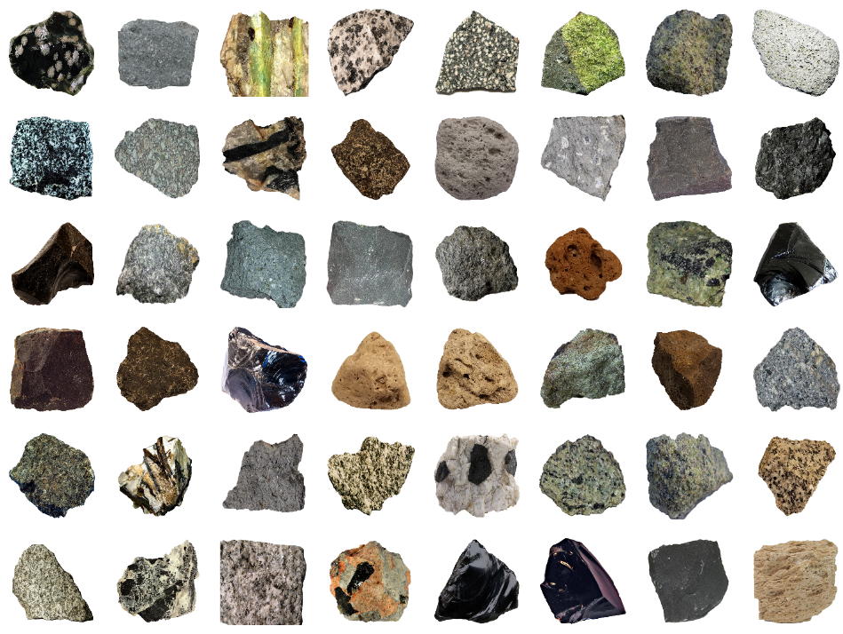
On each trial, you will start by seeing
a grid of rocks, like below.
These are examples of the rocks you will learn to classify.
On each trial, you will use the mouse to click on one of the rocks that you want to learn about.
Notes:
SC

Slide 4
On each trial, you will start by seeing
a grid of rocks, like below.
These are examples of the rocks you will learn to classify.
On each trial, you’ll use the mouse to click a button in the middle of the screen. The computer will then select one of the rocks from the grid.
Notes:
TC

Slide 5
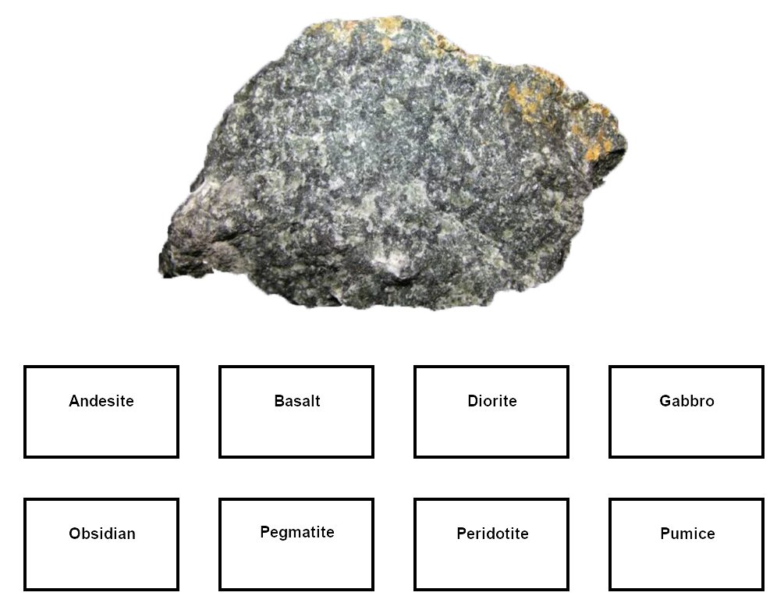
Then you will see an enlarged picture of the rock, with buttons on the screen with the different types, like below.
Make your best guess at identifying the rock by clicking one of the buttons. After you make your selection, the computer will tell you the correct answer.

Slide 6
At first you will be guessing, but by paying attention to the rocks and the correct answers provided by the computer, you should gradually learn to identify the rocks.

Slide 7
After each of the training blocks that we
just described, you will be tested on
what you have learned in a test block. We will explain the test blocks after you complete your first training block.
The experiment consists of 9 cycles of training and test blocks, with 16 trials per each block.
Notes:
xxxxx

Slide 8
Your goal is to learn to correctly classify the rocks into as many of the 8 geological types as you can during the TEST blocks.
The TRAINING blocks are there to help you learn the rock categories, but your performance during the training blocks is not being recorded by the computer.

Slide 9
During training, you shouldn’t waste time selecting rocks from categories that you have already learned. Instead, we recommend that you should select rocks from categories that you still need to learn!
Notes:
xxxxx

Slide 10
On each trial of learning, we will give you a recommendation of which rock to choose by placing a square around it.
The recommendation is based on what we think will be the best choice to help you learn the categories. You may choose to follow our recommendation or select another rock that you feel is more useful.
Notes:
xxxxx

Slide 11
After each of the training blocks that we
just described, you will be tested on
what you have learned in a test block. We will explain the test blocks after you complete your first training block.
The experiment consists of 9 cycles of
training and test blocks,
with 16 trials per each block.

Slide 12
Your goal is to learn to correctly classify the rocks into as many of the 8 geological types as you can during the TEST blocks
The TRAINING blocks are there to help you learn the rock categories, but your performance during the training blocks is not being recorded by the computer.
Notes:
xxxxxx

Slide 13
Important!
The $3 bonus payment is based only on your TEST performance during the final three test rounds of the study. Your answers during TRAINING trials do not matter for the bonus payment.
Reminder: Stay in full screen mode throughout the full study. If you exit full screen mode you will return to Prolific, and no compensation will be provided.
Notes:
xxxxx

Slide 14
You will now start the first test block of the experiment.
During the test, you will be classifying rocks into the same 8 geological types as before.
However, you will be seeing new rocks from each of the 8 geological types.

Slide 15
On each trial, the computer will display a single rock on the screen, along with the buttons.
As before, make your best guess of which type the rock belongs to by clicking one of the buttons.
In the test block, the computer will not tell you whether your answer was correct.
Instead, the computer will just say 'Okay' to let you know it recorded your response.
However, the computer will tell you your overall percent correct for each rock type at the end of each test block.

Slide 16
Your goal is to learn to correctly classify the rocks into as many of the 8 geological types as you can during these TEST blocks.
Each test block has 16 trials.

Slide 17
You finished the main experiment!
One of the major goals in introductory college-level science classes is to teach students the major categories in the domain of study. In the present example, we are interested in the teaching of rock categories in the geologic sciences
An important issue is whether students learn more effectively if teachers provide the examples of the categories that need to be learned or if students choose the examples on their own.
Depending on which condition you were randomly assigned to, you received either teacher-chosen examples or you chose the examples on your own. The results of this experiment will provide important information about which teaching method is more effective.

